Slide 1
REGULATION SPACES IN SD42 SCHOOLS

Slide 2
THE SPA OR THE GYM?
Does the student need an active break (gym) to help down-regulate, or do they need a quiet, chill (spa) break?
They may benefit from both environments, at different times of the day. It is important there is a plan of what activities will be tried prior to entering any space.
It is important that the adult and student are engaged together throughout, and that active breaks (“gym”) are structured.

Slide 3
New “spa” spaces IN sd42

Slide 4
KEY COMPONENTS
Adult-supported space to improve SEL skills and connection with child: ST or EA
Target population identified by school team
Clear expectations, routines and structure for how to use the space
Notes:
Target population – from Cole: Completely depends on the types of students in the school, and who the team foresees the space having the biggest impact on. The GOAL is to help shape their SEL skills and strengthen relationships and connections with adults in the school.
Sign in/out process, visuals on wall to support understanding of expectations

Slide 5
HARRY HOOGE’S HAVEN

Slide 6
HARRY HOOGE’S HAVEN

Slide 7
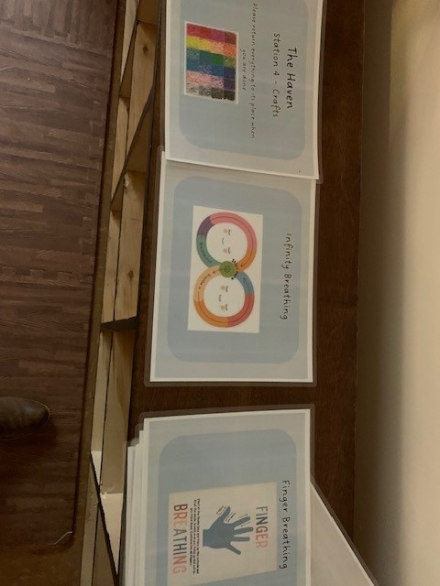
SIGN IN/OUT; STATIONS

Slide 8
HIGHLAND PARK: THE NEST
The Nest Room Tour.MOV
Notes:
The Nest Room Tour.MOV

Slide 9
MAPLE RIDGE: THE GROVE
The Grove.MOV (sharepoint.com)

Slide 10
DAVIE JONES: THE REEF
The Reef Video (DJ).MOV (sharepoint.com)

Slide 11
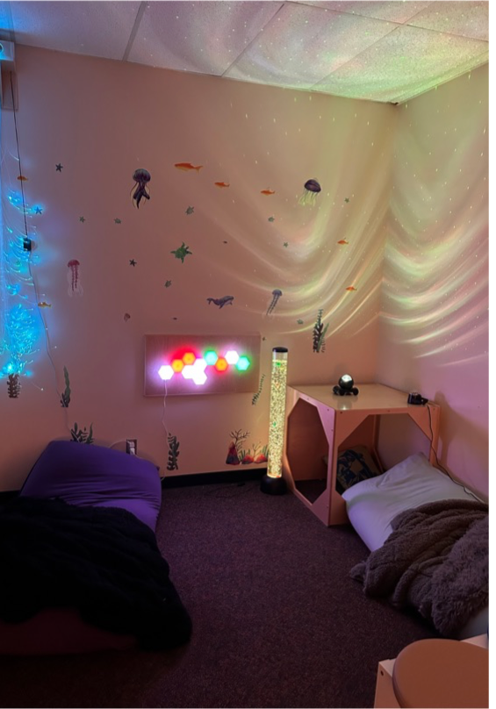
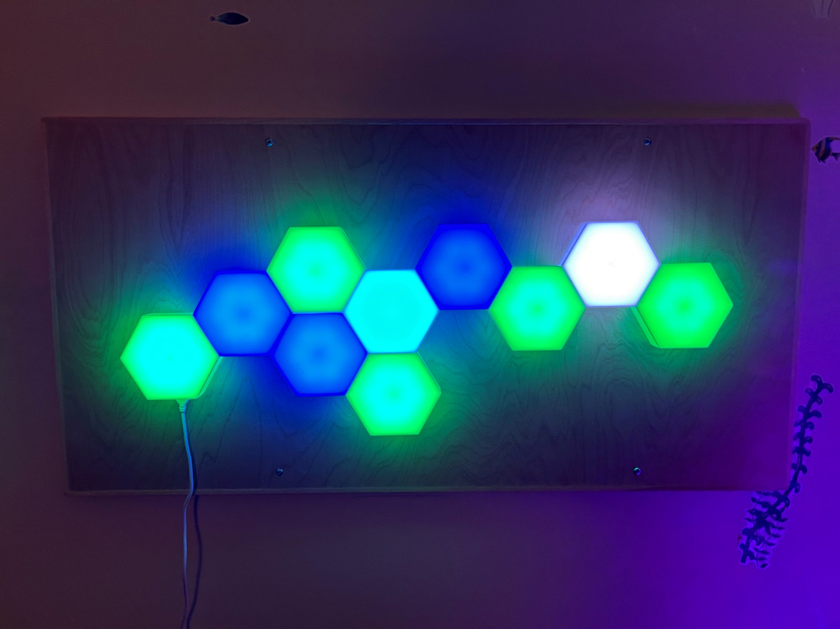
Davie Jones: THE REEF

Slide 12
HAMMOND: THE OASIS
The Oasis (HA).MOV (sharepoint.com)

Slide 13
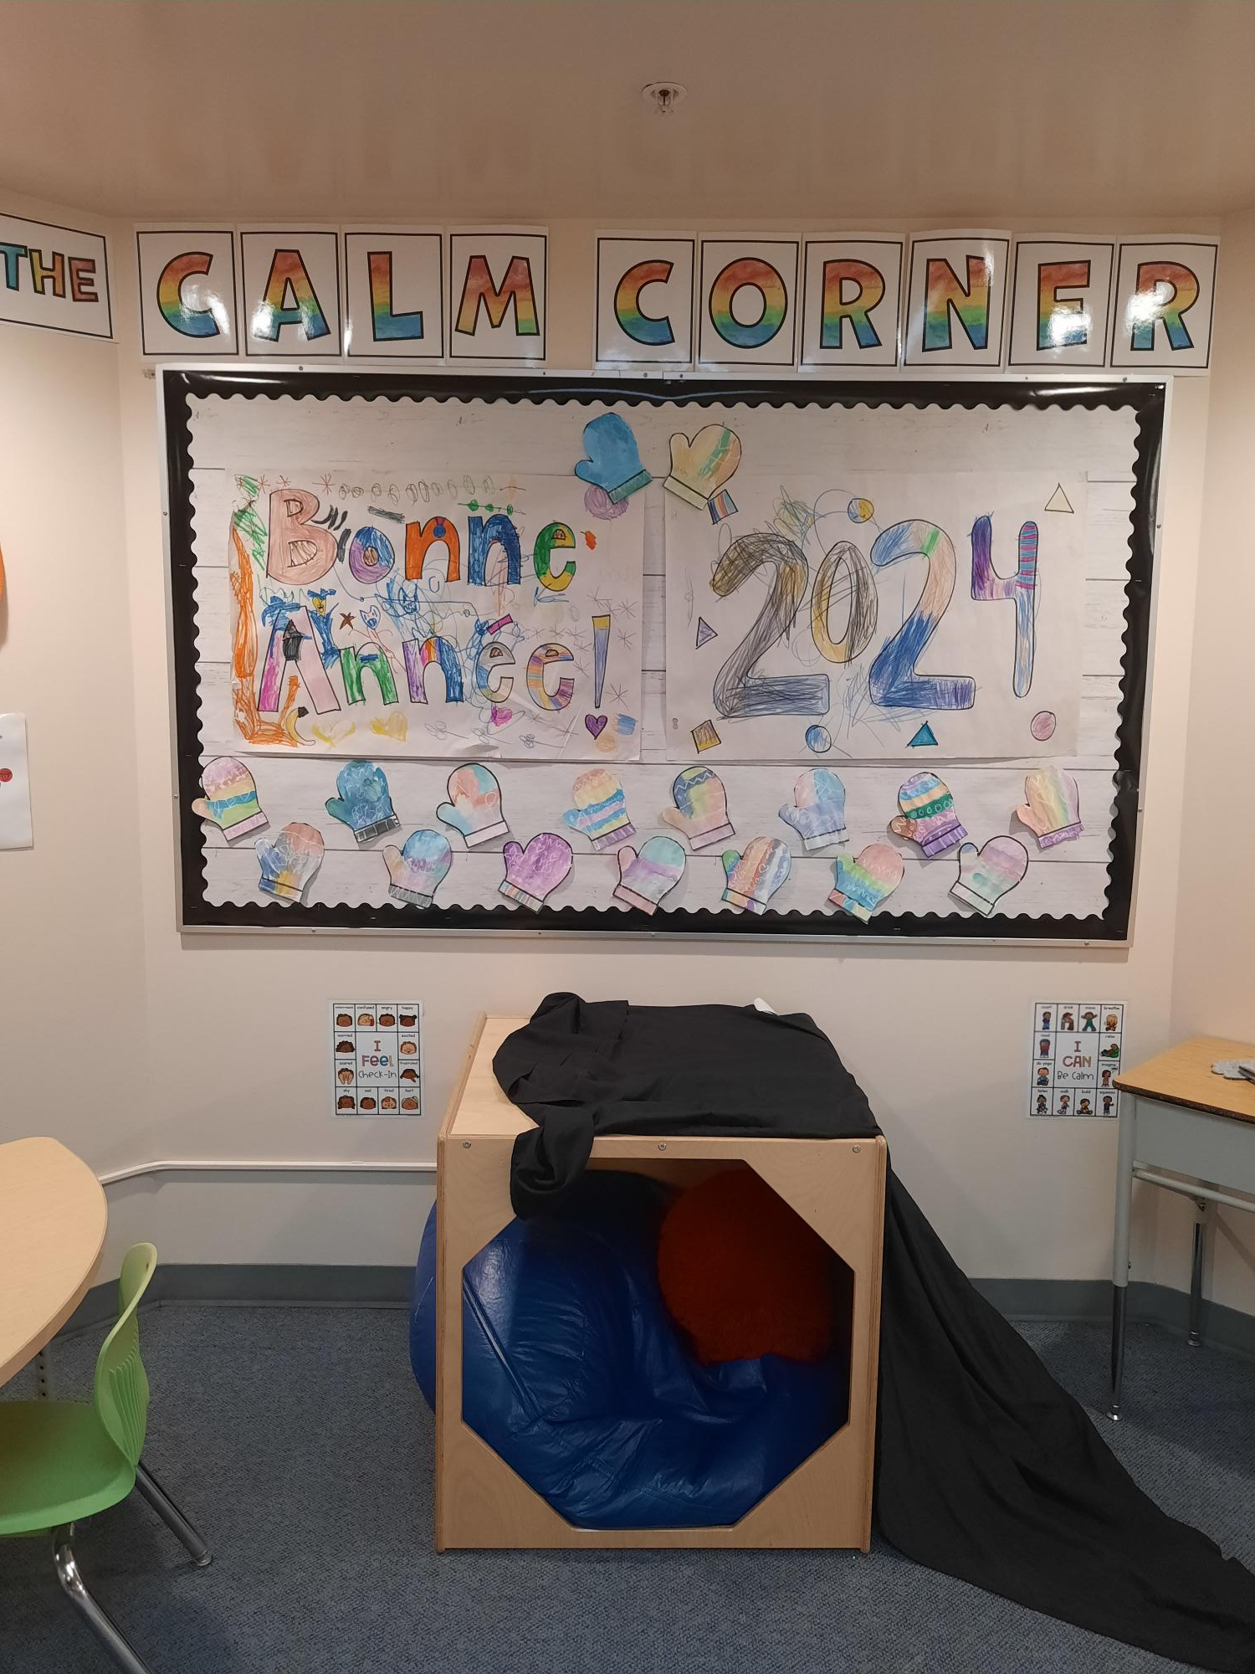
MRE: CALM CORNER IN HALLWAY

Slide 14
‘GYM’/ACTIVE SPACES
Notes:
Circuit/stations on the wall, review session with OT and EAs using space so they are clear on what activities they can try out, area is cleaned-up between students.

Slide 15
CLASSROOM DESIGN INSPIRATION: MME CUNLIFFE @ LV

Slide 16
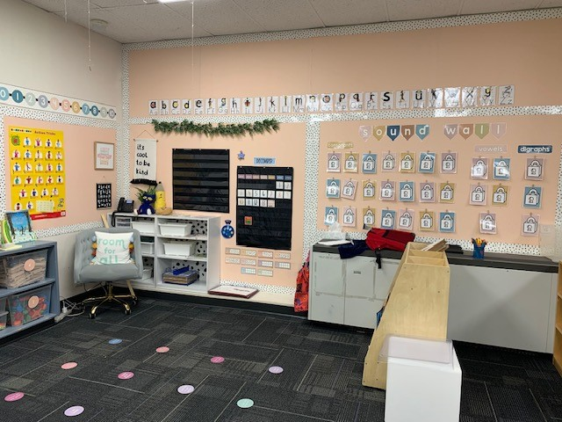
Ms. LeiEr’s Classroom GE
Notes:
Borders – visually regulating

Slide 17
ALOUETTE ELEMENTARY OFFICE
Notes:
Things you can’t see easily; Diffuser – smell; music – calming, snacks on front counter

Slide 18
RESOURCES
Classroom Design Checklist: OT website
https://ls.sd42.ca/wp-content/uploads/2018/06/Classroom-Design-Considerations-Handout1.pdf

